Slide 1
Community Connection
OB’s Supporting Breastfeeding
March 6, 2024
By Breastfeed Durham
BreastfeedDurham.org

Slide 2
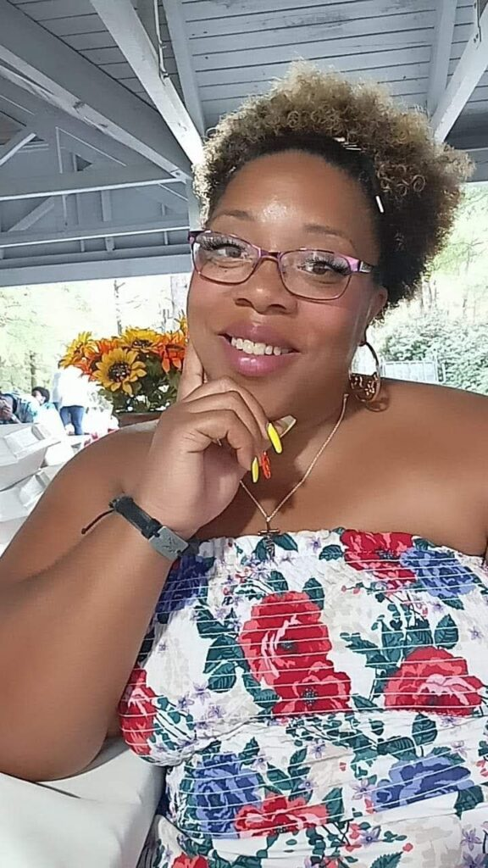
Disclosure
I have no conflict of interest, however I believe that lived experience impacts us all.
Executive Director and Board Member of Breastfeed Durham:
Board Member of Fatherhood of Durham:
Background in Childcare and Community Health:
Worked with the Durham Headstart program
Served as a Community Health Worker with the Durham County Department of Public Health
Personal Experience and Advocacy:
As a mother and grandmother who has breastfed five children, she brings personal experience to her advocacy work.
Her motto, “A happy mom breastfeeding is a happy baby eating,” reflects her philosophy of supporting and empowering breastfeeding mothers.
Community Engagement and Support:
Regularly attends community events, fostering connections and offering support.
Known as the “resource lady” in her community, highlighting her role in providing information and resources related to chest/breastfeeding and other relevant topics.
Bernadette Greene's dedication to her community and her roles in various organizations showcase her commitment to supporting families, promoting health and wellbeing, and being a valuable resource for parents in Durham.

Slide 3
Disclosure
I have no conflict of interest, however I believe that lived experience impacts us all.
Passionate parent from a mixed race background
Children with special needs
Volunteer and breastfeeding advocate
La Leche League Leader
President of NC Breastfeeding Coalition
Volunteering is inherently inequitable
Data Nerd
Community Health Worker/COO
Breastfeed Durham working
Breastfeeding Family Friendly Communities

Slide 4
Learning Objectives
Understand the Impact of Lived Experience: Recognize how personal and community experiences shape breastfeeding and support, emphasizing the importance of diverse perspectives in healthcare provision.
Highlight the Importance of Community Engagement: Discuss the role of community involvement and support in encouraging and facilitating breastfeeding, including the significance of local resources and peer support.
Examine Interdisciplinary Collaboration: Outline the benefits and methods of integrating services from lactation consultants, doulas, and community health workers into the continuum of care for breastfeeding families.
Navigate and Utilize Local Resources: Provide a comprehensive overview of available lactation support credentials, professions, and resources to ensure OBs and healthcare providers can effectively refer and support breastfeeding families.

Slide 5
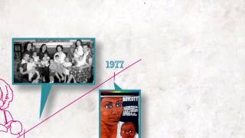

Slide 6
Lactation is the intersection of
food and sexuality.
What's more cultural than that?

Slide 7
What cultural barriers exist between the provider and family?
Who are you?

Slide 8
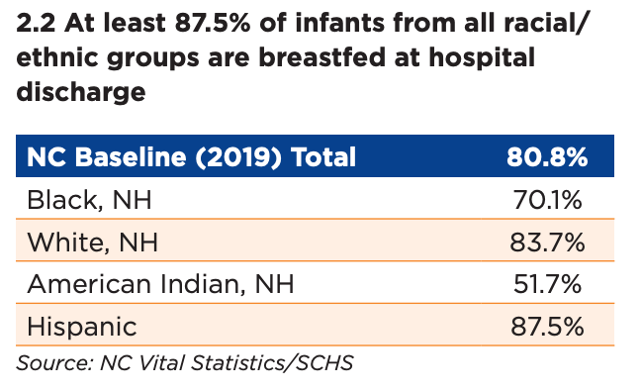
Women are 2.5 times more likely to breastfeed where breastfeeding is Supported and Promoted.

Slide 9
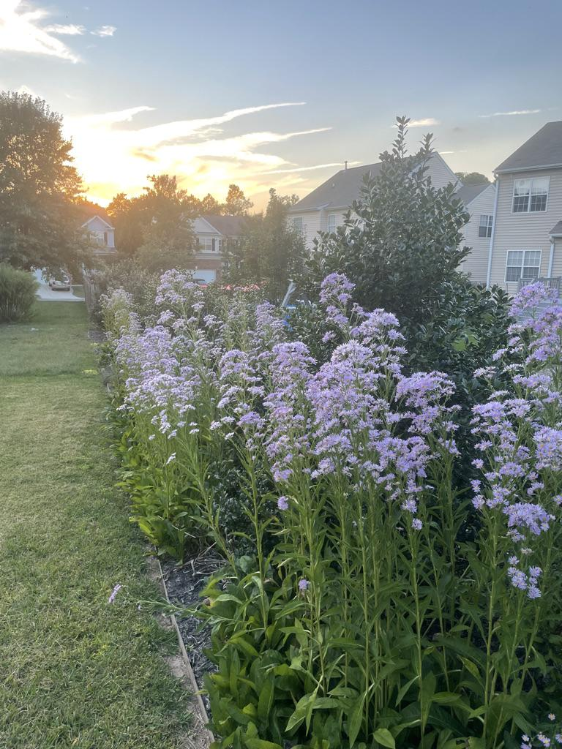
Presenting from Durham, NC
Lumbee and Saponi Land
https://native-land.ca/
Strives to create and foster conversations about the history of colonialism, Indigenous ways of knowing, and settler-Indigenous relations, through educational resources such as our map and Territory Acknowledgement Guide. Native Land Digital creates spaces where non-Indigenous people can be invited and challenged to learn more about the lands they inhabit, the history of those lands, and how to actively be part of a better future going forward together.

Slide 10
We move between several different cultures
– often without even thinking about it.
Age ~ Appearance
Race ~ Ethnicity
Socioeconomic status ~ Life experiences
Sexual orientation ~ Gender identity
Religion
Language ~ Location ~ National origin/Geographically bounded
Social groups
Professional Status
Physical Accessibility
Neurodiversity
Education
Familial status ~ Relationship status
Worldview
Who are you?

Slide 11
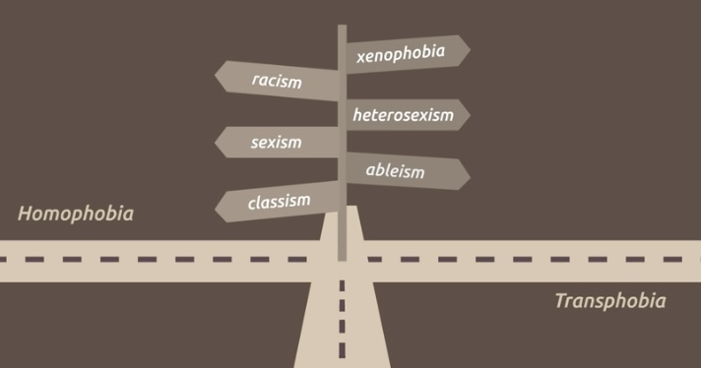
Kimberlé Crenshaw uses the term "intersectionality" to describe the phenomenon of “standing in the path of multiple forms of exclusion.”
Intersectionality

Slide 12
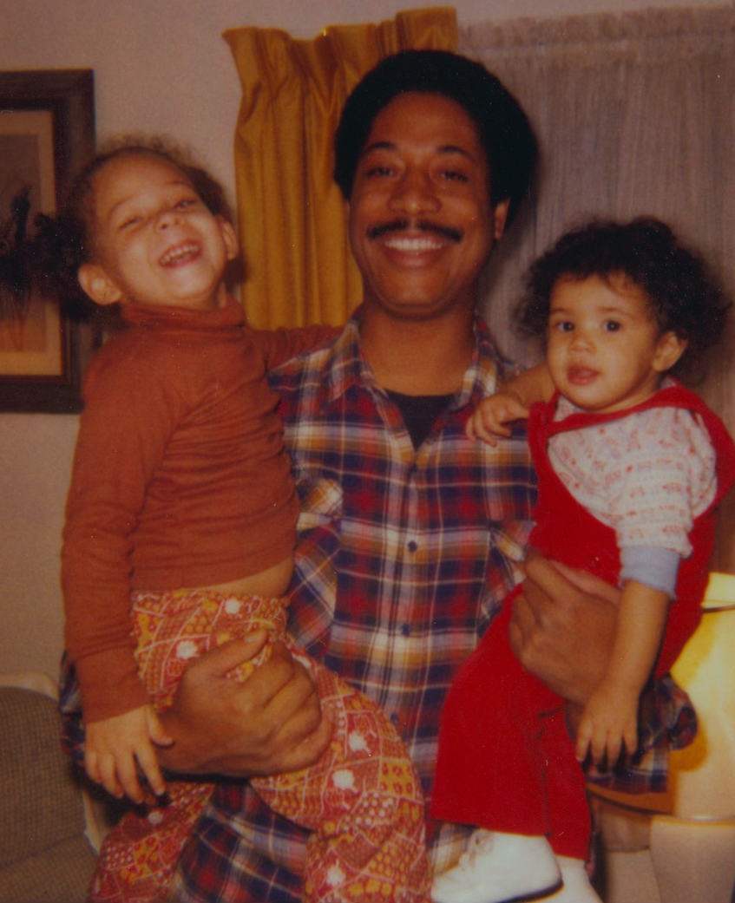
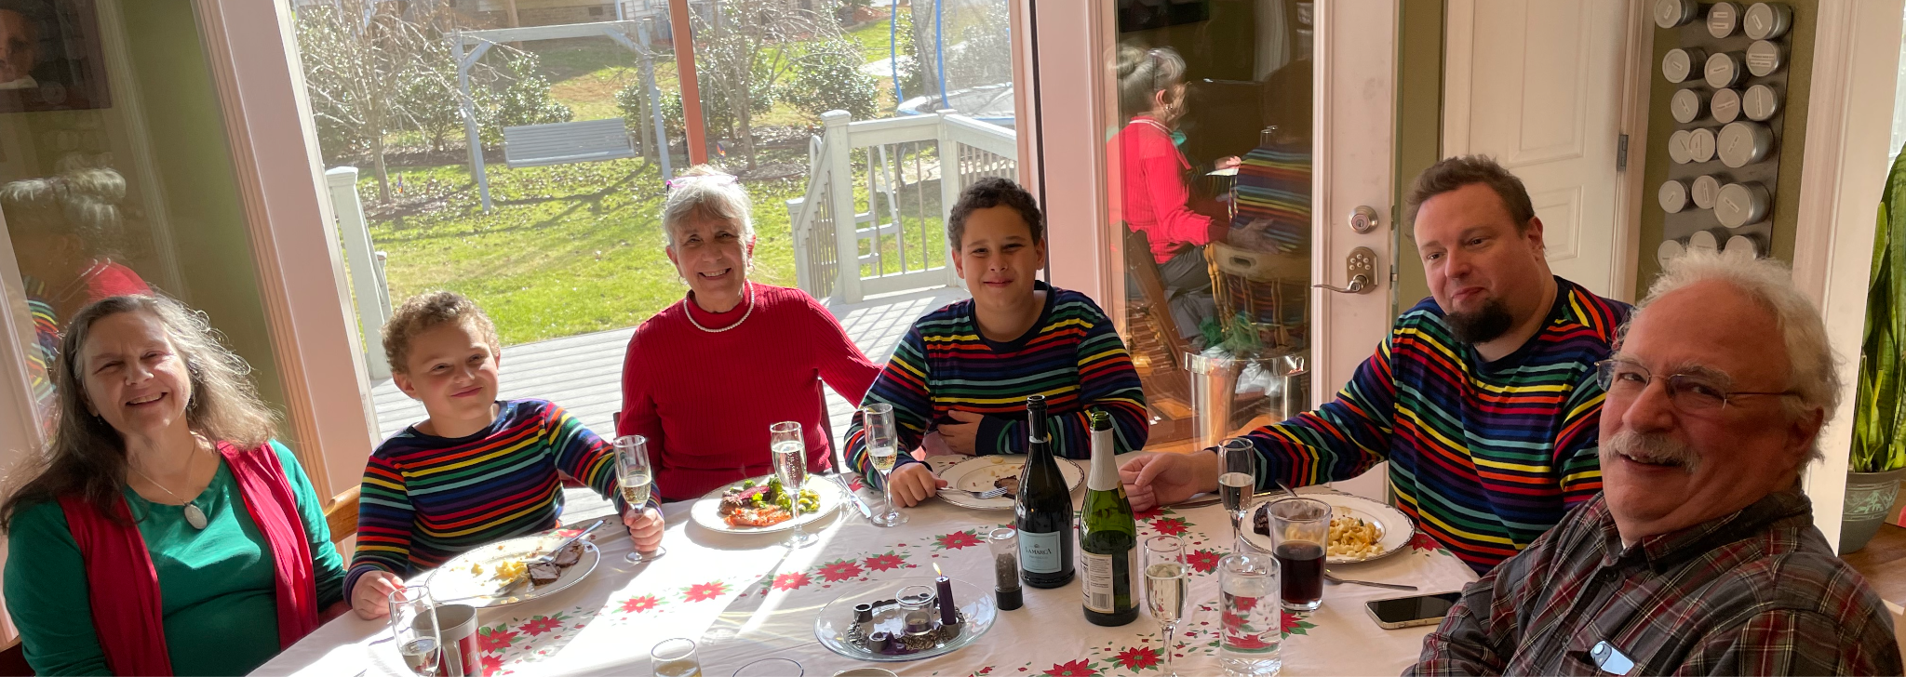
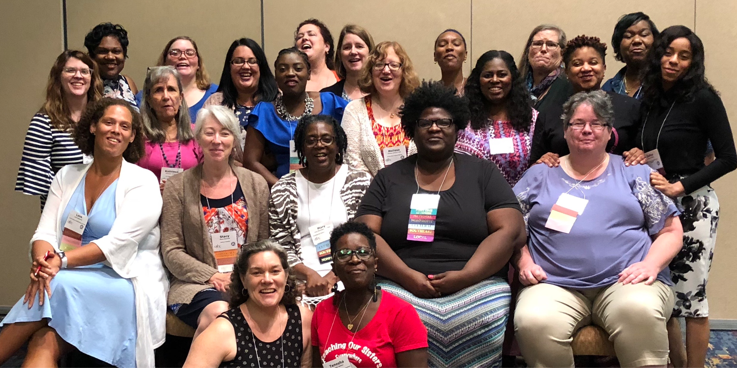
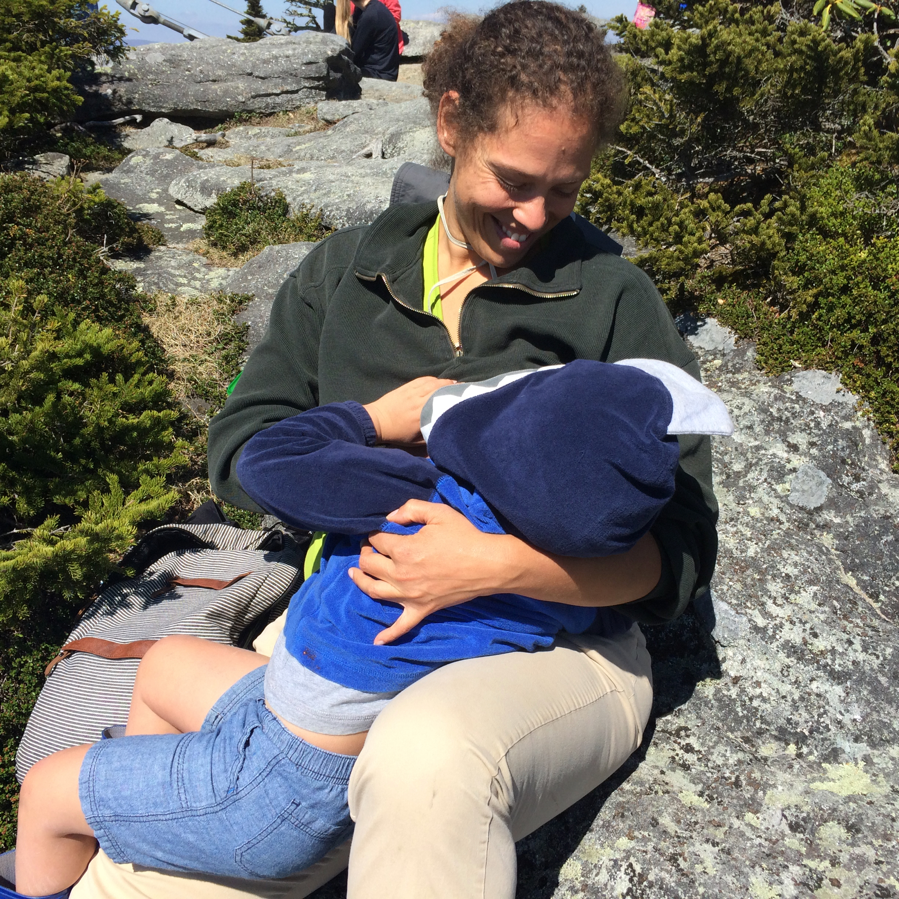
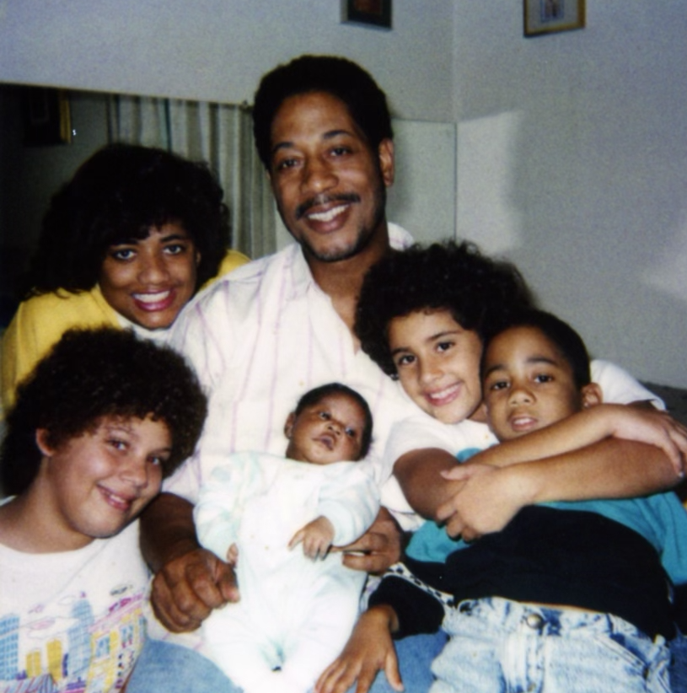
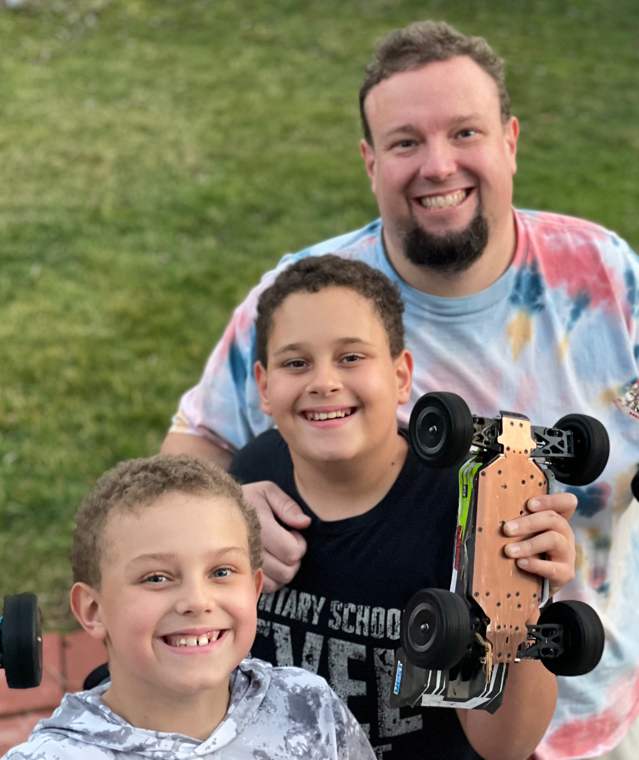
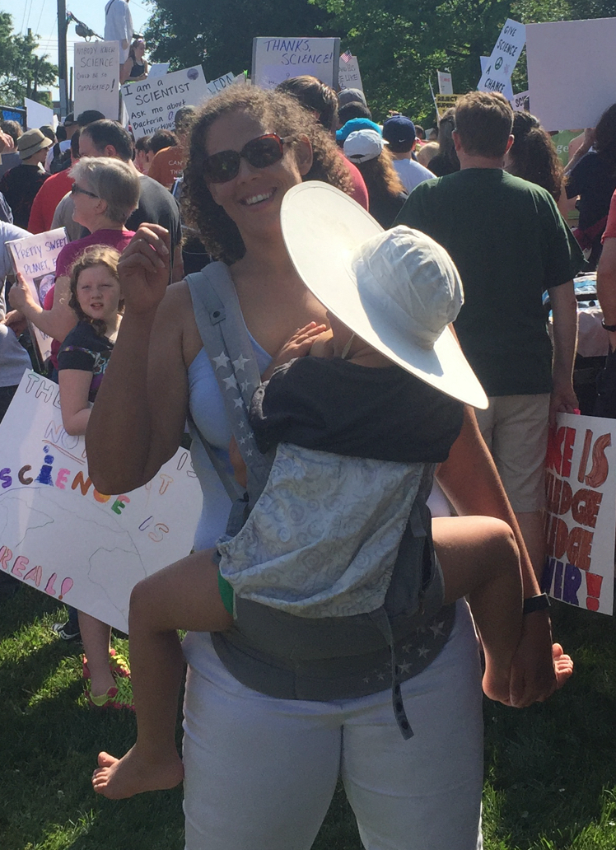
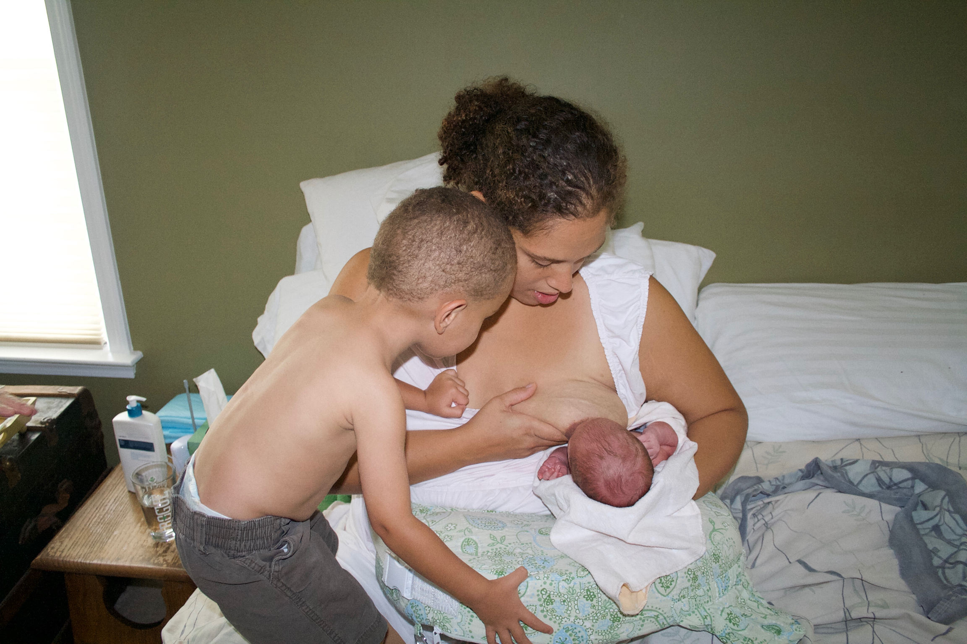
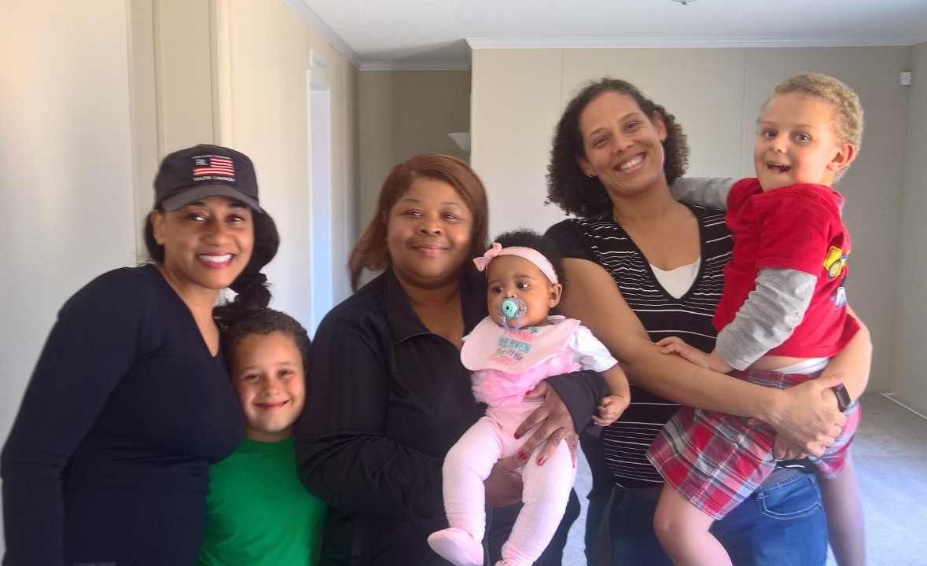
Provider Culture
Meets Patient Culture

Slide 13
What cultural barriers exist between the provider and family?
Who are you?

Slide 14
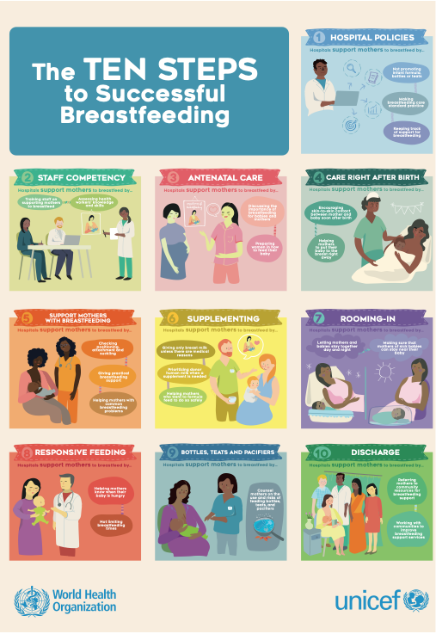
So many TEN Steps!
Awards and Designations
WHO and UNICEF launched the Baby-friendly Hospital Initiative (BFHI) and Ten steps to successful breastfeeding to help motivate facilities providing maternity and newborn services worldwide to implement the Ten Steps to Successful Breastfeeding.
Notes:
Critical management procedures:
1a. Comply fully with the International Code of Marketing of Breast-milk Substitutes and relevant World Health Assembly resolutions.
1b. Have a written infant feeding policy that is routinely communicated to staff and parents.
1c. Establish ongoing monitoring and data-management systems.
2. Ensure that staff have sufficient knowledge, competence and skills to support breastfeeding.
Key clinical practices:
3. Discuss the importance and management of breastfeeding with pregnant women and their families.
4. Facilitate immediate and uninterrupted skin-to-skin contact and support mothers to initiate breastfeeding as soon as possible after birth.
5. Support [FAMILIES] to initiate and maintain breastfeeding and manage common difficulties.
6. Do not provide breastfed newborns any food or fluids other than breast milk, unless medically indicated.
7. Enable [FAMILIES] and their infants to remain together and to practise rooming-in 24 hours a day.
8. Support [FAMILIES] to recognize and respond to their infants’ cues for feeding.
9. Counsel [FAMILIES] on the use and risks of feeding bottles, teats and pacifiers.
10. Coordinate discharge so that parents and their infants have timely access to ongoing support and care.

Slide 15
Why have TEN Steps for a Community?
Families need breastfeeding, chestfeeding, and human milk feeding support beyond the hospital…
Families need a supportive community.
Communities need to collaborate to support families.
Government, Healthcare, Community Support Providers,
Local Businesses, Nonprofits, Local Faith Communities,
Childcare Providers, Local Schools, and more...
We need to Engage the Whole Community!

Slide 16
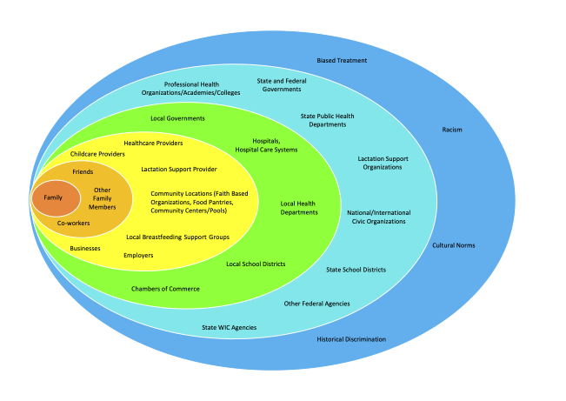
Support and safeguard the nursing family.
An ecological model shows the ever expanding environment for protection, promotion, and support of breastfeeding, chestfeeding, and human milk feeding.

Slide 17
The Breastfeeding Family Friendly Communities (BFFC) initiative is a community-wide program to impact Health Equity, as supported by the World Health Organization guidelines to work with communities to improve breast/chestfeeding support services.
Notes:
The Breastfeeding family Friendly Communities initiative began as a pilot project in Chapel Hill and Carrboro, North Carolina, in 2014, with a vision to improve lactation duration by developing a set of measures to guide communities to welcome lactating families in all the spaces and places in which families live and work and shop and play. The measures, fondly called the Ten Steps to a Breastfeeding Family Friendly Community, foster continuity of care from pregnancy to birth to the family’s intended time to wean by building awareness of the community’s role in supporting families and providing measures and approaches to build a welcoming environment.
Development of the Breastfeeding Family Friendly Communities initiative was led by Dr. Miriam Labbok, then director of the Carolina Global Breastfeeding Institute (CGBI), who desired to see healthier, more welcoming communities for young lactating families of all races and ethnicities. Unfortunately, Dr. Labbok passed away before realizing this vision. After Dr. Labbok’s passing, members of the Chapel Hill and Carrboro implementation team received the support of CGBI to continue the work locally and to expand nationally and globally. In 2018, Breastfeeding Family Friendly Communities of Durham, now Breastfeed Durham, became the second community to begin the Ten Steps journey, and in 2020, with the enthusiasm and vision of new partners, the initiative in Chapel Hill and Carrboro grew to include communities in the entire county. To further support the initiative, Breastfeeding Family Friendly Communities incorporated in May, 2020, and was awarded 501c3 status in October, 2020. Currently, Breastfeeding Family Friendly Communities provides ongoing technical assistance and support to active communities in four states and 10 communities and has provided preliminary support to additional communities to explore the Ten Steps.

Slide 18
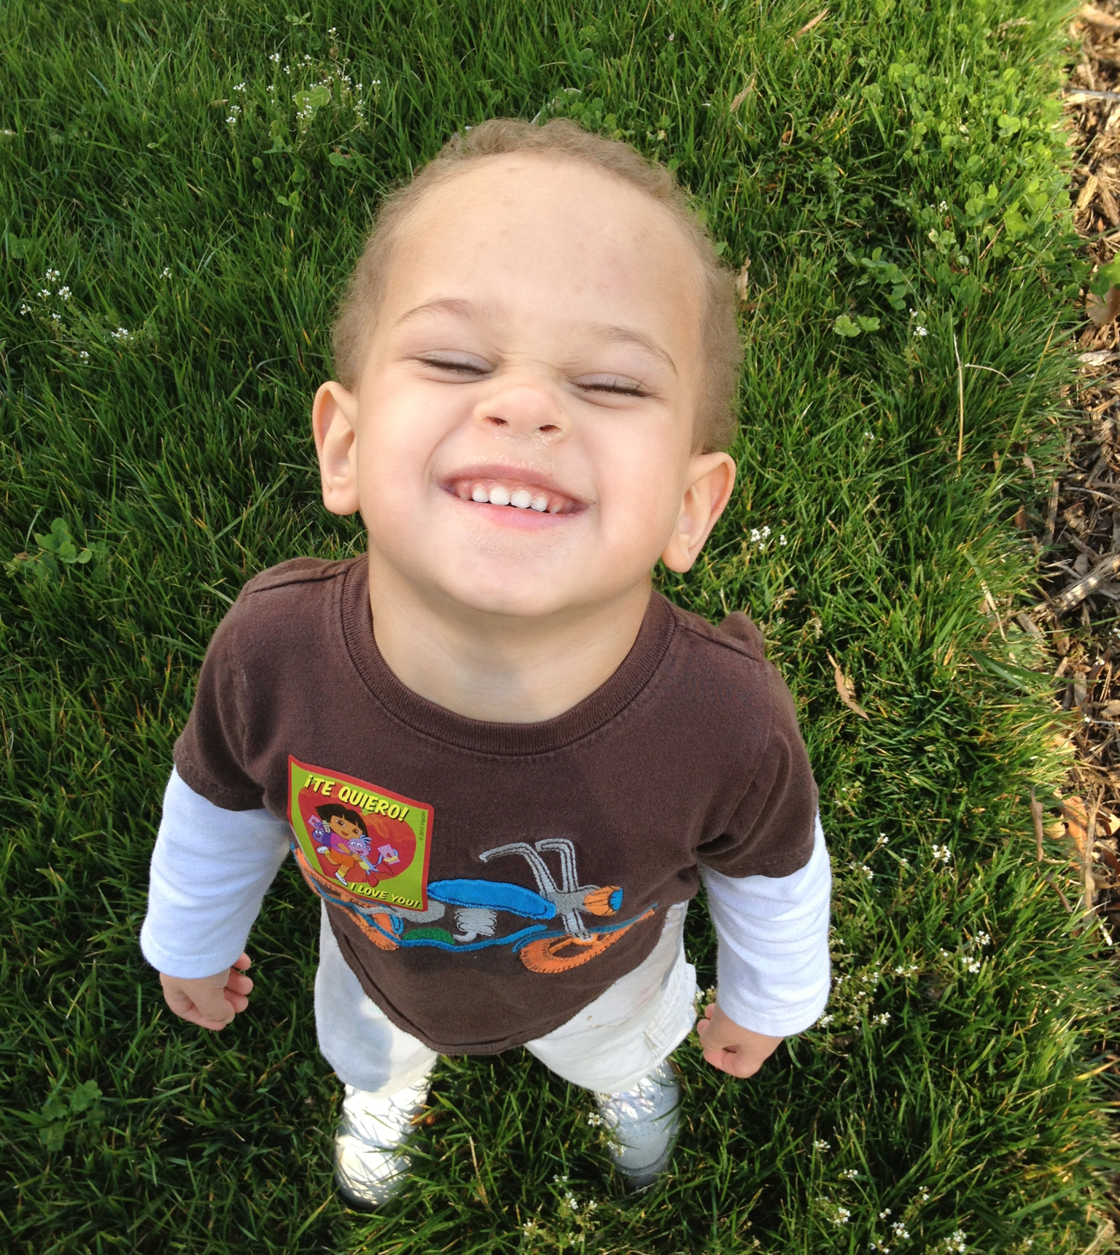
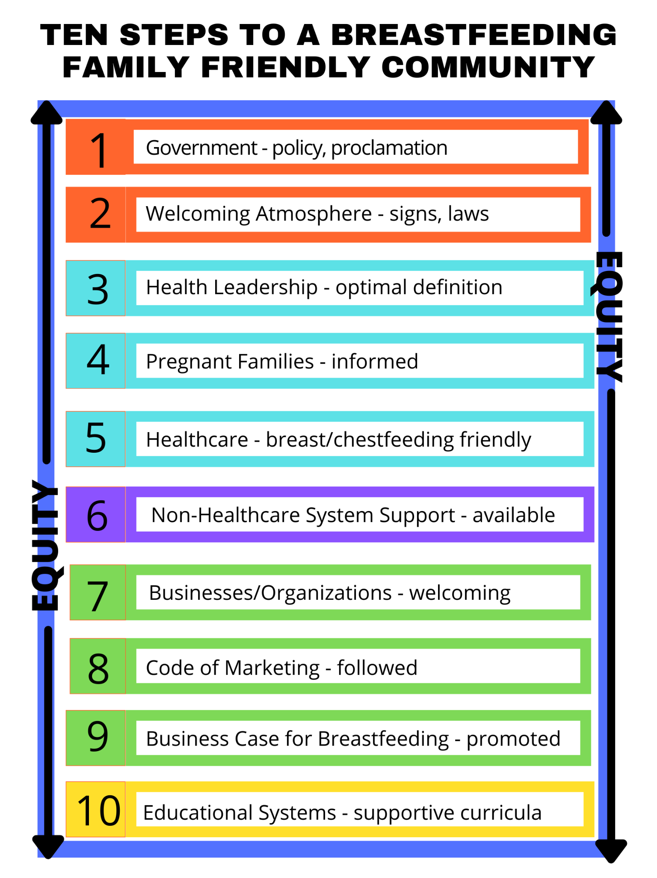
Ten Steps to a Breastfeeding Family Friendly Community

Slide 19
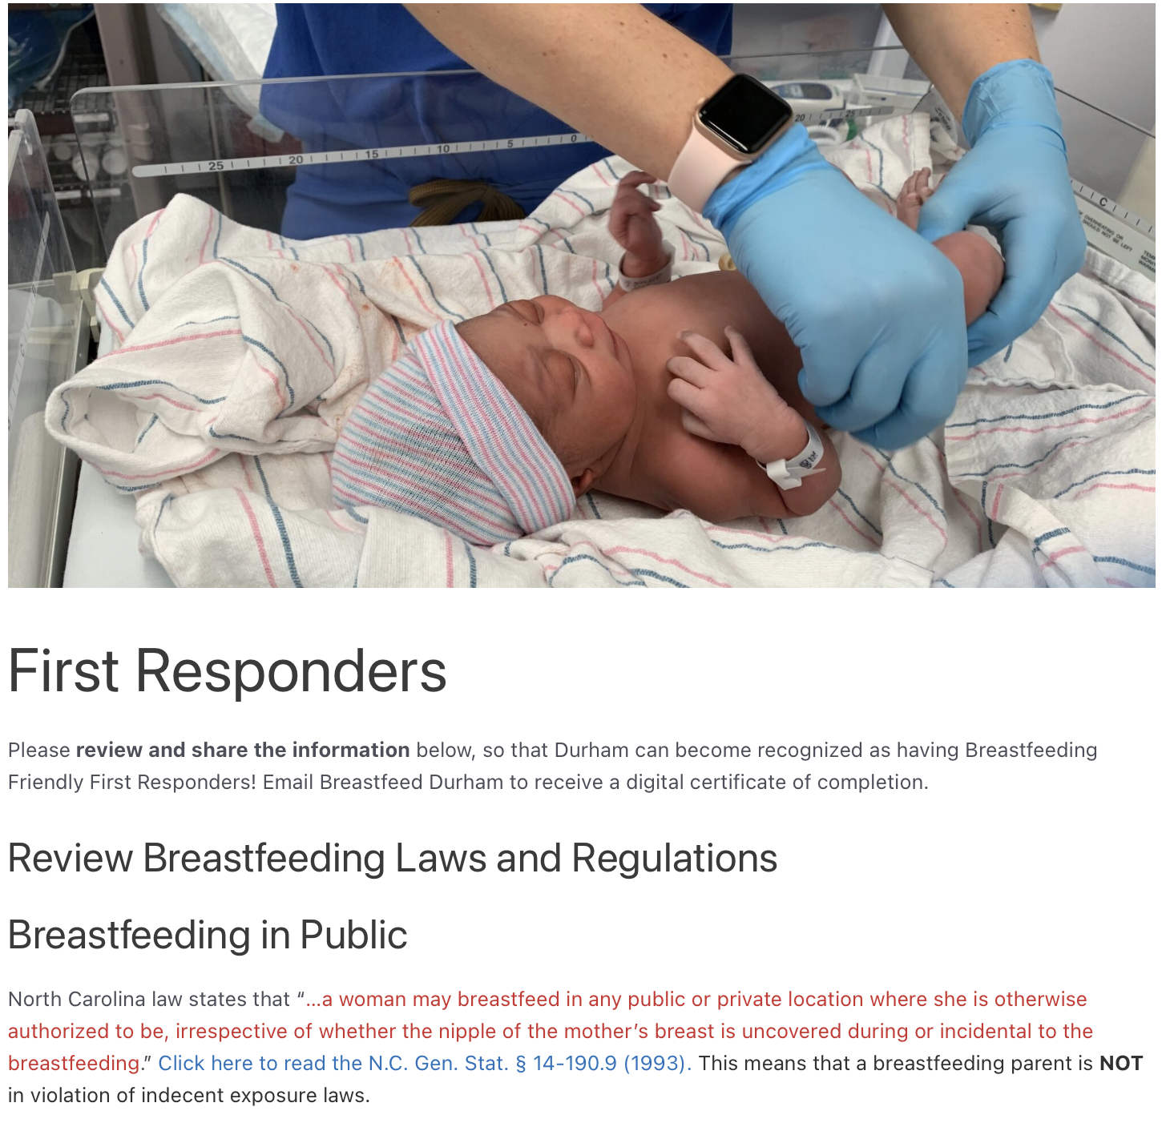
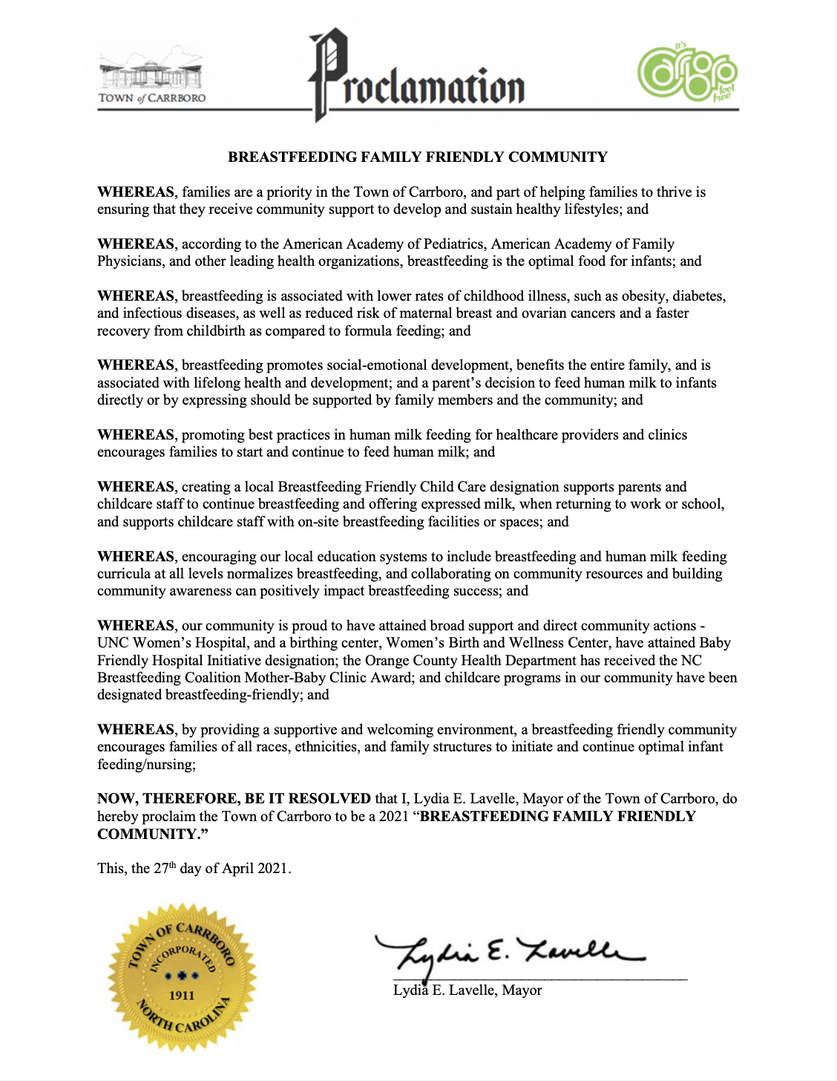

Slide 20
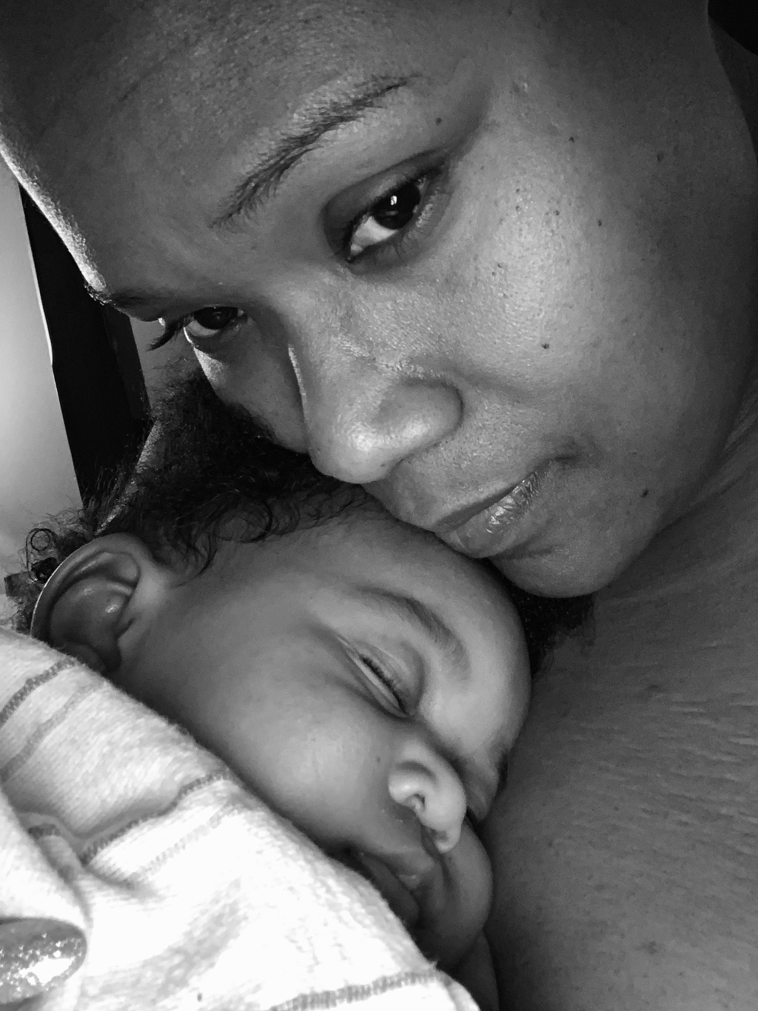
First Food Equity
A Shared Responsibility
Even though it’s legal to breastfeed in public in all 50 states, there are countless instances of people being asked to leave or cover up – or even having the police called – while nursing. Many of those impacted are families of color – specifically, undocumented families, immigrant families, and families who have been racialized and criminalized and have every reason to avoid police contact.
Parents feeding their infant with a bottle are never asked to leave a public space. We strongly believe that chest/breastfeeding families should be treated the same in public spaces.
Notes:
Even though it’s legal to breastfeed in public in all 50 states, there are countless instances of people being asked to leave or cover up – or even having the police called – while nursing. Many of the impacted families are families of color – specifically, undocumented families, immigrant families, and families who have been racialized and criminalized and have every reason to avoid police contact. We are in communication with all the first responders in Durham about how they can better support families in Durham, but the threat of police interaction for breastfeeding in public is real. We would highlight that a parent feeding their infant with a bottle is never asked to leave a public space. We strongly believe that both families are providing life-sustaining food to their infants and should be treated the same in public spaces.

Slide 21
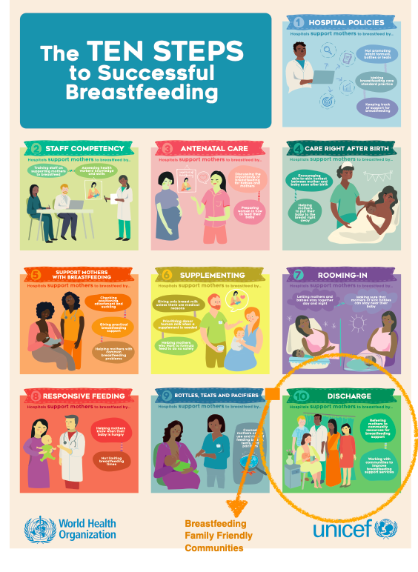
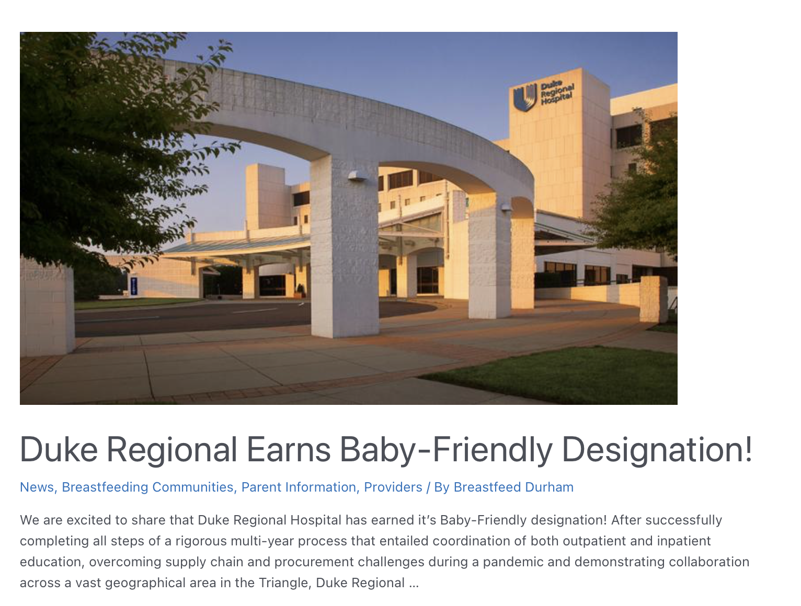

Slide 22
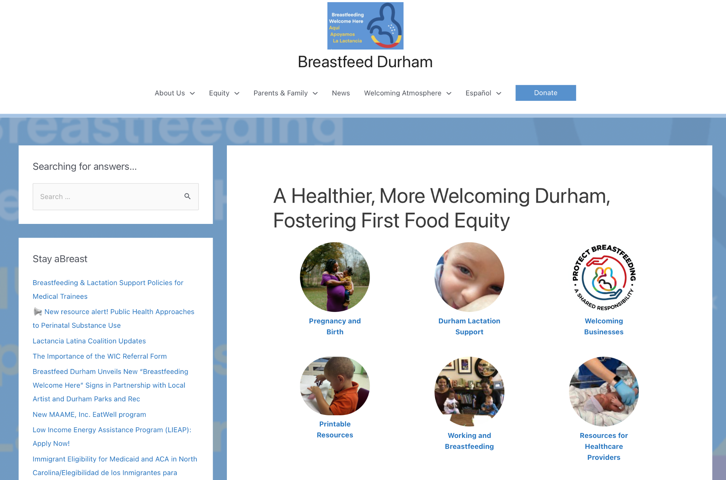
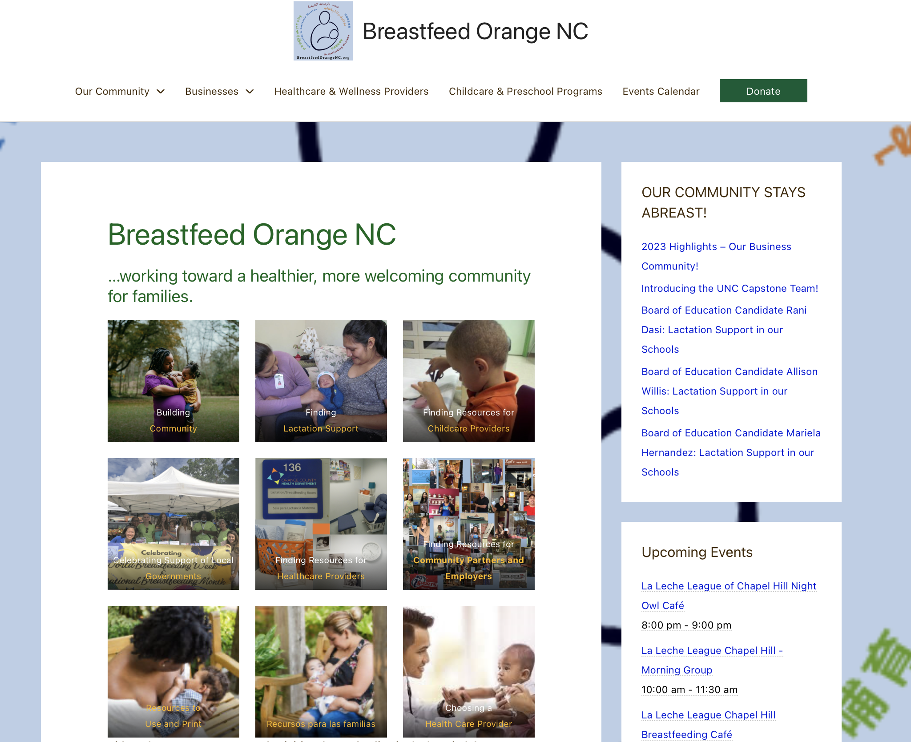
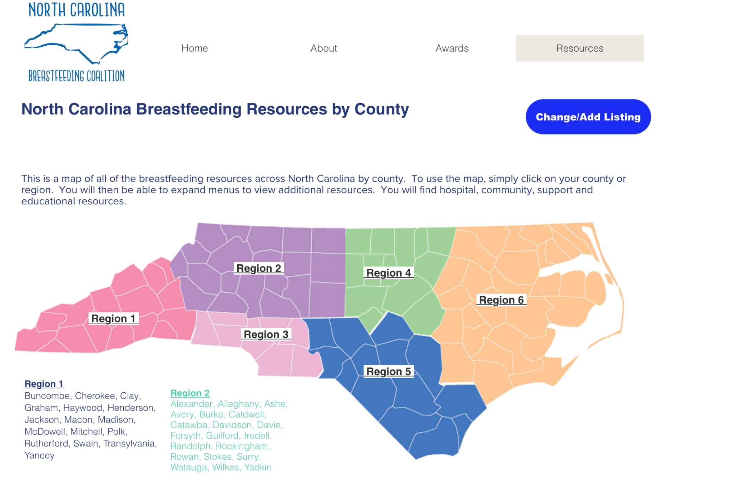

Slide 23
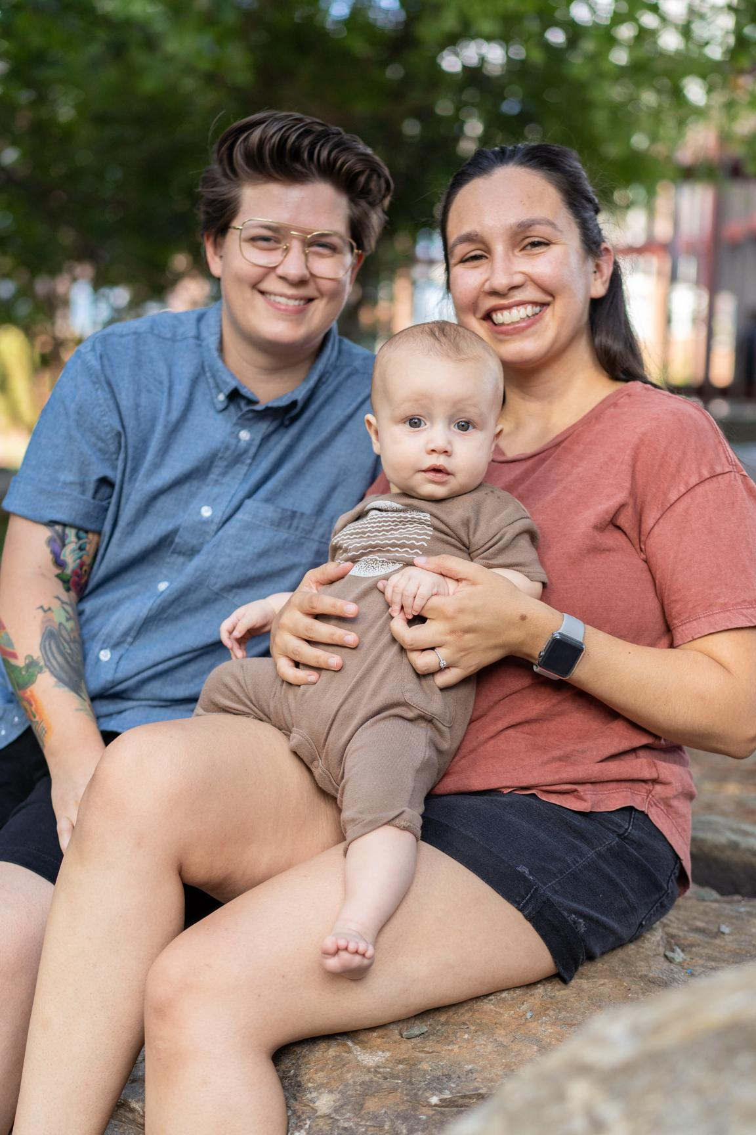
Asheville/Buncombe County, North Carolina
Chatham County, North Carolina
Chester, Pennsylvania
Cincinnati and Surrounding Counties, Ohio
Cumberland County, North Carolina
Durham, North Carolina
Elizabeth City, North Carolina
Franklin County, North Carolina
Hampton Roads Region, Virginia
Hendersonville/Henderson County, North Carolina
Hoke County, North Carolina
Lycoming Clinton, Pennsylvania
Montgomery County, North Carolina
Orange County, North Carolina
Queens, New York
Richmond County, North Carolina
Richmond, Virginia
Scotland County, North Carolina
South Bend, Indiana
Williamsport, Pennsylvania
Wilkinsburg, Pennsylvania
Wood County, Wisconsin
Local Communities
Notes:
Include advocating for breastfeeding friendly and equitable health care policies and practices for families by supporting healthcare providers to be accountable for top quality and equitable care
Commonly Requested Templates
View the Ten Steps to Breastfeeding Family Friendly Communities (BFFC) Initiative as supported by the World Health Organization.
View Frequently Asked Questions (FAQs) on Breastfeeding Family Friendly Community Designation.
View the Breastfeeding Family Friendly Community Self-Appraisal of approaches and measures.
Download the Global Criteria.
Download an example of a Business application.
Download the Health Care Provider application.
Download example proclamations: Carrboro/Chapel Hill Proclamation or Durham Proclamation.

Slide 24
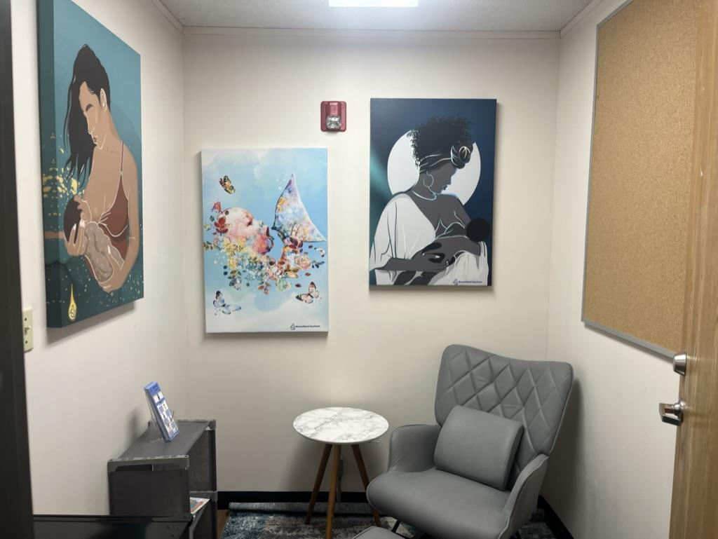
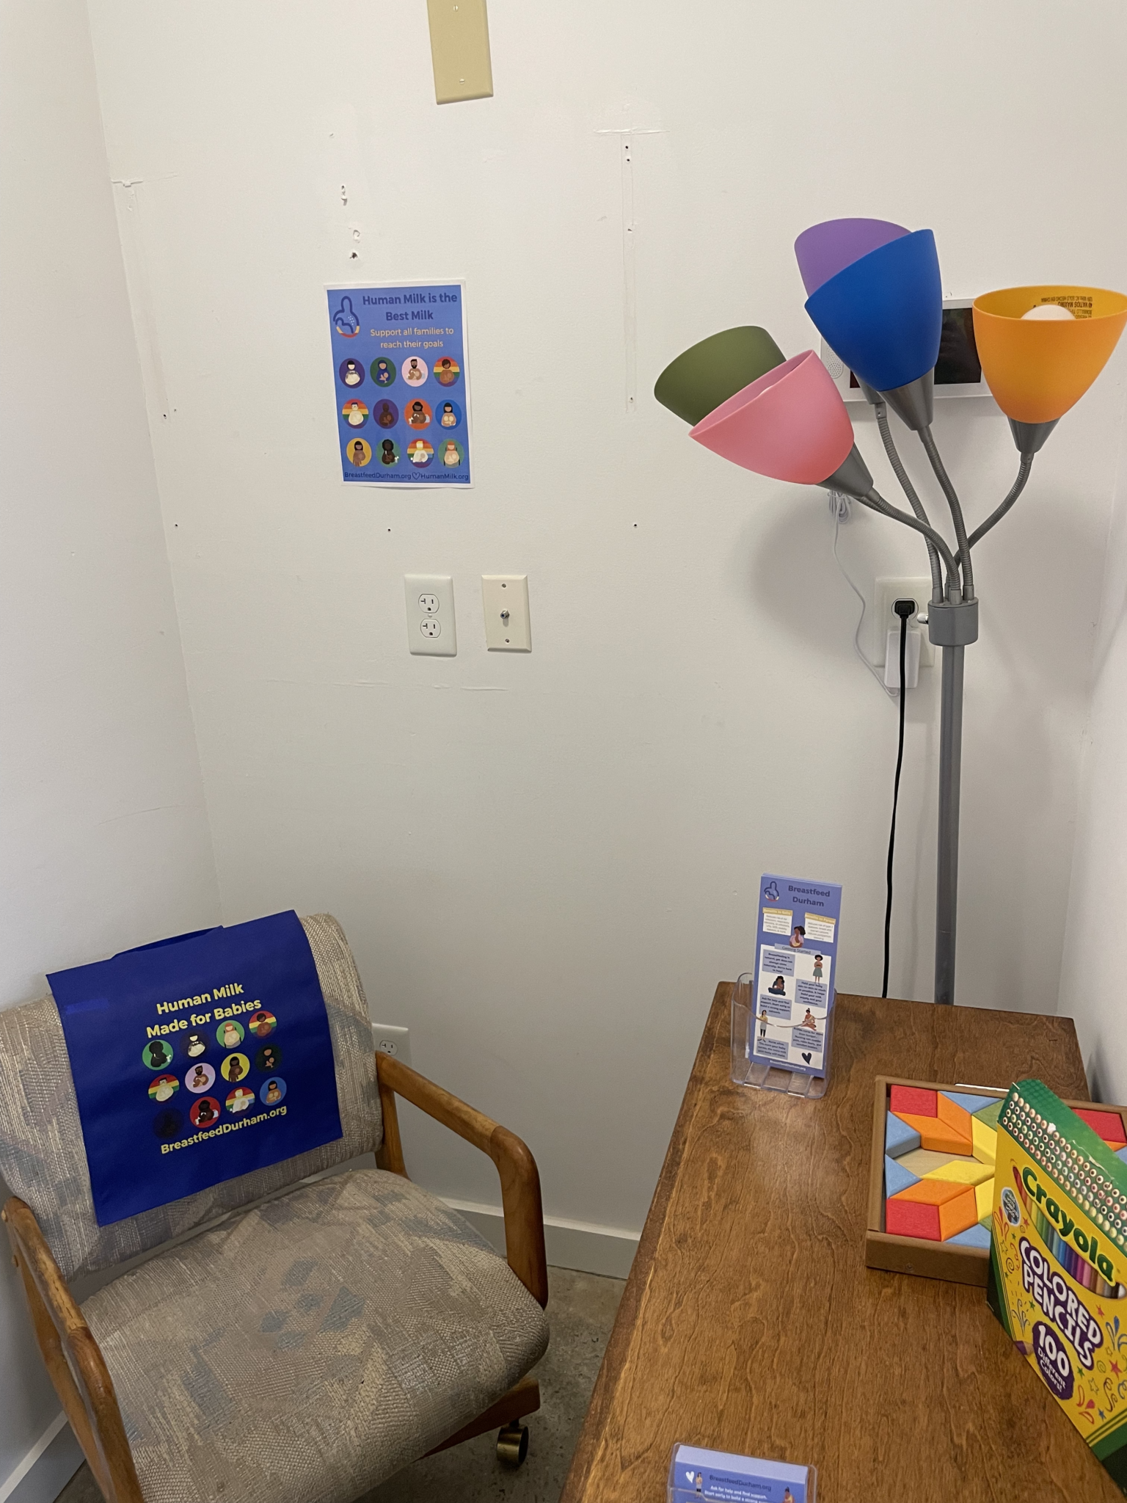
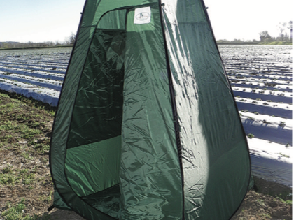
https://breastfeeddurham.org/new-lactation-areas-in-durham-businesses/

Slide 25
STEP 10. Education systems, including childcare, K-12, colleges and universities, are encouraged to include breastfeeding-friendly curricula at all levels.

Slide 26
Recognize the importance of equity in all components of the initiative

Slide 27
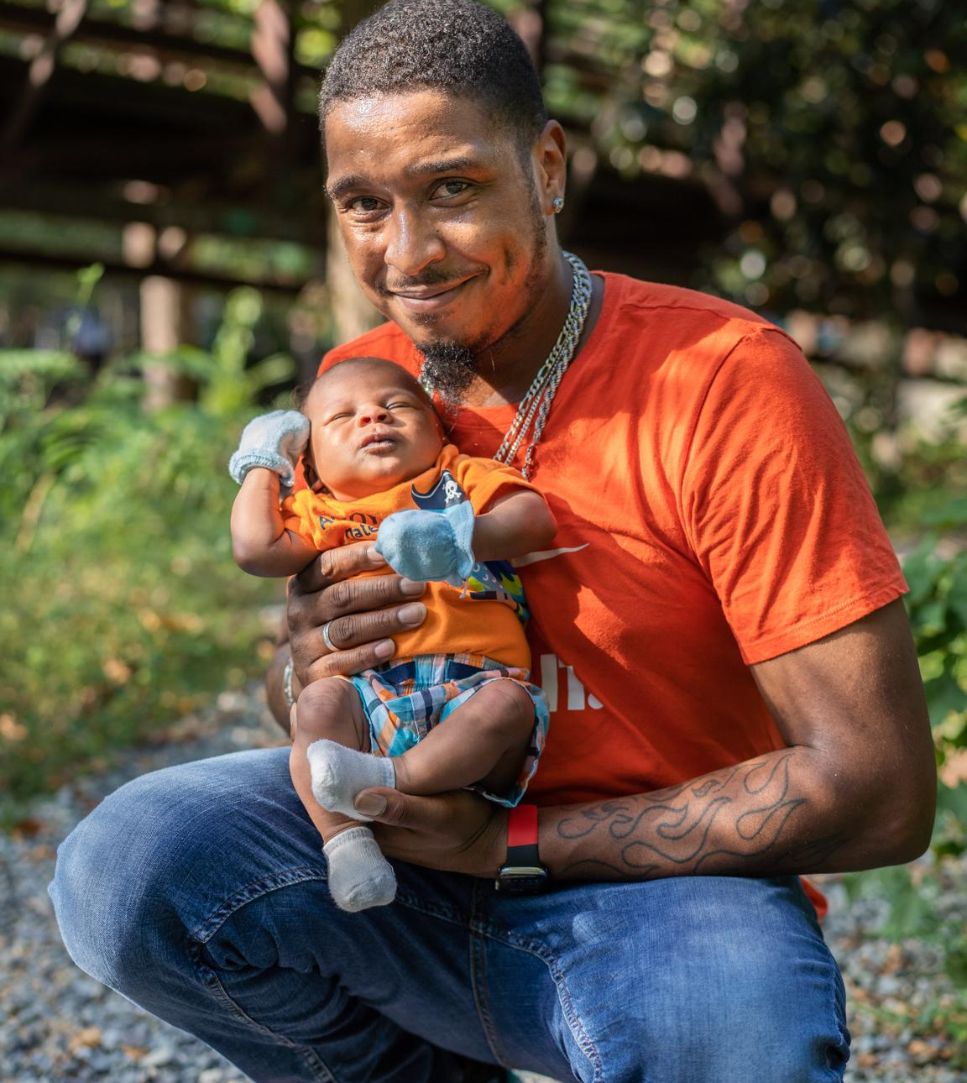
First Food Equity
A Shared Responsibility
Ultimately, Breastfeeding Family Friendly Communities (BFFC) exists because no family in this country gets enough support.
Though infant feeding is often framed as a “choice,” there is no real choice when there is no federal paid time off, no universal and affordable/free childcare, no living wage requirements, and inequitable lactation support. If you are a parent, we support you and we are walking this journey with you.

Slide 28
Imagine a world where the very first need
of every person in our community is met.

Slide 29
Okay…so what can you do?
Ask…
“Have you thought about how you're going to feed your baby?”

Slide 30
My Personal Statement
Even when you feel powerless, you can hold yourself accountable.
Envisioning a world in which parents, families, and babies leverage their expertise to transform systems to live full and healthy lives.
Unapologetically committed to racial and gender equity – which includes Indigenous, Black, Brown, Latinex, Middle Eastern, and Asian/Pacific Islander parents, babies, and families including nonbinary parents, both transgender and cisgender. Remember that chest/breastfeeding is not just for white women.
Increasing connectivity between existing parts of the community and elevating the work of historically marginalized community members with the voices of Black and Brown lactating parents at the center.
Acting on health equity outcomes at all ages and stages of life, breast/chestfeeding is essential for family, perinatal, maternal, and child health.

Slide 31
Navigate and Utilize Local Resources
for Infant Feeding Support

Slide 32
Comprehensive List of Lactation Support Credentials and Professions
Lactation Consultant (LC): This term can sometimes be used broadly to describe anyone who provides lactation consulting services. The specific title and scope of practice can vary based on the certification and training received.
International Board Certified Lactation Consultant (IBCLC): IBCLCs are healthcare professionals who specialize in the clinical management of breastfeeding. They are certified by the International Board of Lactation Consultant Examiners (IBLCE) after completing extensive education and clinical hours and passing an exam. IBCLCs work in various settings, including hospitals, clinics, and private practice, providing expert breastfeeding and lactation care, from basic support to managing complex challenges.
Certified Lactation Counselor (CLC): CLCs have received training and certification through the Academy of Lactation Policy and Practice. Their education focuses on the basics of breastfeeding support, including helping parents with latch issues, providing emotional support, and educating families about the benefits of breastfeeding. CLCs often work in community settings, hospitals, and clinics.
Certified Lactation Educator (CLE): CLEs focus on educating parents, families, and professionals about breastfeeding and human lactation. They are trained to provide up-to-date information and support to encourage successful breastfeeding. Their certification often comes from various organizations and is ideal for those looking to incorporate lactation education into their existing professional practice.
La Leche League Leader (LLL Leader): LLL Leaders are parents with lived lactation experience who have completed accreditation through La Leche League International. They provide free support and education to breastfeeding mothers through meetings and one-on-one support, often in a community setting.
Breastfeeding Peer Counselor: Typically part of a community health program, such as WIC (Women, Infants, and Children), peer counselors are mothers who have successfully breastfed and received training to support other mothers. They offer basic breastfeeding information and encouragement.
WIC Breastfeeding Peer Counselor: Similar to breastfeeding peer counselors, these individuals are specifically trained under the WIC program to offer support and education on breastfeeding to low-income women and families. They share their own experiences and provide practical advice to help mothers achieve their breastfeeding goals.
Doula with Lactation Support Training: Doulas are professionals trained to provide emotional, physical, and educational support to mothers during the prenatal period, childbirth, and postpartum. Those with additional training in peer-to-peer lactation support can also offer guidance and support for breastfeeding.
North American Board of Breastfeeding and Lactation Medicine (NABBLM-C): The new credential for doctors in the field of breastfeeding and lactation medicine. This board was established to set standards in physician training, knowledge, skills, and certification specifically in Breastfeeding and Lactation Medicine for both Canada and the USA. NABBLM offers board certification to physicians who demonstrate an expertise in diagnosing and managing breastfeeding and lactation-related problems using evidence-based medicine.

Slide 33
Breastfeeding Resources
Resource | What did I like or dislike about the resource and why?
Human Milk Banking Association | My favorite thing about the Milk Bank is their donation for people who have experienced a loss. They are so sensitive. They thought of so much. The downside is the amount of milk that you have to have in order to donate.
The Womanly Art of Breastfeeding 8th edition | This was my introduction to breastfeeding and parenting. I read every pregnancy book, but I really didn't think about parenting until I had the baby in my arms. I expected it to be easy. I adored the stories at the beginning of the Womanly Art. However, I hated the going-back-to-work section. Here are good resources for going back to work https://workwellnc.com/NCMakingItWork.php https://www.womenshealth.gov/breastfeeding
Region | NCBC | This resource lists almost everything. I don't like the way the resource does not rank the quality of the support.
Global Health Media Videos — English | I think the videos are great, however, I wish that the images represented more Americans and looked less international.
Breastfeed Durham | I am the Director of Breastfeed Durham, and I helped to gather all of these resources and share them with the health department over the last few years. It is hard to keep everything up to date.
Global and National Breastfeeding Resources from BFFC | I am on the board. So I think this is a great list, but again it is hard to keep everything up to date.
Carolina Global Breastfeeding Institute | I love these resources. They are always adding new information. I find it hard to keep up with all the additions and connect with the information that I'm looking for.
This may include videos, books, handouts, or websites available for you to use at your worksite.

Slide 34
As reproductive health experts and advocates for women's health who work in conjunction with other obstetric and pediatric health care providers, obstetrician–gynecologists are uniquely positioned to enable women to achieve their infant feeding goals.
Enabling women to breastfeed is a public health priority because, on a population level, interruption of lactation is associated with adverse health outcomes for the woman and her child, including higher maternal risks of breast cancer, ovarian cancer, diabetes, hypertension, and heart disease, and greater infant risks of infectious disease, sudden infant death syndrome, and metabolic disease.
Contraindications to breastfeeding are few.
https://www.acog.org/clinical/clinical-guidance/committee-opinion/articles/2018/10/optimizing-support-for-breastfeeding-as-part-of-obstetric-practice#:~:text=Obstetrician%E2%80%93gynecologists%20and%20other%20obstetric%20care%20providers%20should%20support%20each,for%20her%20and%20her%20infant.
What does ACOG say?

Slide 35
Community Connections
I asked our mailing list of 500 community advocates what they thought you needed to know…

Slide 36
Dear Breastfeed Durham Community,
I hope this message finds you well and thriving in your important work supporting lactating families. Wednesday, I have the opportunity to discuss with an Obstetrician (OB) students how to strengthen the collaboration between healthcare providers, lactation consultants, doulas, and peer-to-peer lactation support providers. Part of our mission is to amplify your voice, I would like to integrate your perspective.
Do you have any thoughts on how can OBs foster stronger collaborative relationships with your work (lactation consultants, doulas, and peer-to-peer support providers, and various other healthcare settings)? If you have a thought, please feel free to share a couple sentences with me.
As someone deeply involved in peer-to-peer lactation support, I had an enlightening conversation with a doctor who shared her practice of referring to Dr. Dotson for complex lactation issues due to medical needs. However, when the conversation turned towards more common lactation challenges, particularly those intertwined with broader parenting questions, she realized the potential of peer-to-peer support groups, which she had momentarily overlooked. This incident highlighted the need for a broader awareness among OBs and other healthcare providers about the rich tapestry of lactation support available in our community, beyond clinical interventions for severe cases. It underscores the importance of fostering a collaborative network that includes a wide range of support options to address the diverse needs of breastfeeding families.
Your expertise and experiences are invaluable in shaping a more integrated support network for lactating families. Please email your recommendations, stories, and any strategies you believe could enhance the collaboration between healthcare providers and lactation support professionals. Together, we can build a stronger foundation for breastfeeding support in our community, ensuring families receive the comprehensive, compassionate care they deserve.
Warmly,
Love Anderson, ABD, LLLL, CLE, CHW, MOM

Slide 37
From my experience, it would be incredibly helpful for them to gain a better knowledge of available resources, and a better understanding of what types of services various professions and agencies/organizations/programs offer. I think the lactation education received during med school and residency is very limited and insufficient. They walk into practice after residency with a knowledge deficit. I would love to see that change.
Some broad concepts that would be helpful for them to gain knowledge of:
Prenatal breastfeeding education – key topics
Attend Ready, Set, Baby! live session to see what their prenatal patients should know and better build their knowledge base to reinforce that patient education and support the evidence based information
Principles of lactogenesis – stages
Anatomy of the breast as it relates to lactation
ABM protocols – all of them! Especially new mastitis spectrum protocol (https://www.bfmed.org/protocols)
New recommendations for breastfeeding and HIV
When supplementing is appropriate/medically necessary
Typical weight loss/gain patterns for breastfed babies – how various birth interventions/birth trauma can influence these patterns
Maternal health conditions that can impact lactation – PCOS, GDM, obesity, smoking, etc.
Resources for medications & lactation – Medications & mothers milk, lactmed, etc.
Support programs
What WIC is, who is eligible, what support/education services the program provides
What a doula is/does, how they support birthing persons
Postpartum home visiting support services
La Leche League and other community support groups
What the skillset/scope is for an IBCLC, how they are a valuable asset to the perinatal healthcare team, how to connect and work collaboratively, when to refer
I could probably continue on and make a much longer list, but these are the key things that I see as lacking when working with providers. I think most are eager to gain knowledge, but don’t know what they are missing, where to go for information, and what resources are out there.
-Alisha Bailey, BS, IBCLC | WIC & Breastfeeding Programs Manager
Piedmont Health Services, Inc.

Slide 38
I thank you for sending this email. As an IBCLC and a birth doula I do find this very very important as well.
I feel I am still learning how to foster good communication but I am also learning what is working and not working.
I think some of the best ways for OBs to build this relationship is know and understand what your scope of practice is and also meeting people in your area that are the experts. When one is confident in their practice then we should be confident enough to reach out to individuals to find the information.
Welcoming doulas into your practice or when in the hospital setting talking to doulas and/or lactations consultants as professionals and not just a fad.
I have realized that when I can talk to a doctor it is because they welcomed me into their space and where I was able to show my knowledge as well as learn from them. What all this does is help to co-treat or come together to be better providers.
I hope this helps but I can continue to give examples how this works for me on a day to day basis.
Jerilyn “Jeri” Free, IBCLC, CD(DONA)

Slide 39
I would ask them what would make them feel comfortable integrating lactation consultants and peer support providers?
Do they need consult reports from us? Do they need information on what the field is?
Do we need to teach in their training programs? Speak at their conferences?
Are they held back by the lack of licensure? Is it just one extra thing to think about?
There are lots of things that we could suggest, but what do they see from their perspective, and how do we work that forward.
I’m delighted you have an opportunity for open conversation. This could lead to some nice collaborations.
-Ellen Chetwynd, PhD., IBCLC

Slide 40
Hi! I work for the interfaith food shuttle and we serve a lot of clients who are pregnant or have young children. A goal of mine has been around creating supportive education that helps women in this time period feel supported while facing food insecurity. We have written a lesson plan for self-paced education and would welcome a LC to review it and/or feel confident sharing it with patients who are food insecure. We’d be happy to provide training on how to screen for food insecurity and then what to do if someone screens positive. I am the director of community health and nutrition and also an RD. I would be thrilled to find ways to support LCs in the work we do.
Kylee McCombs
<kyleejmccombs@gmail.com>

Slide 42
Together, we can build a community of care that prioritizes the health and well-being of families and communities.

Slide 43
Thank you
for all that you do!
A special thank you
to
all of our community partners.

Slide 44
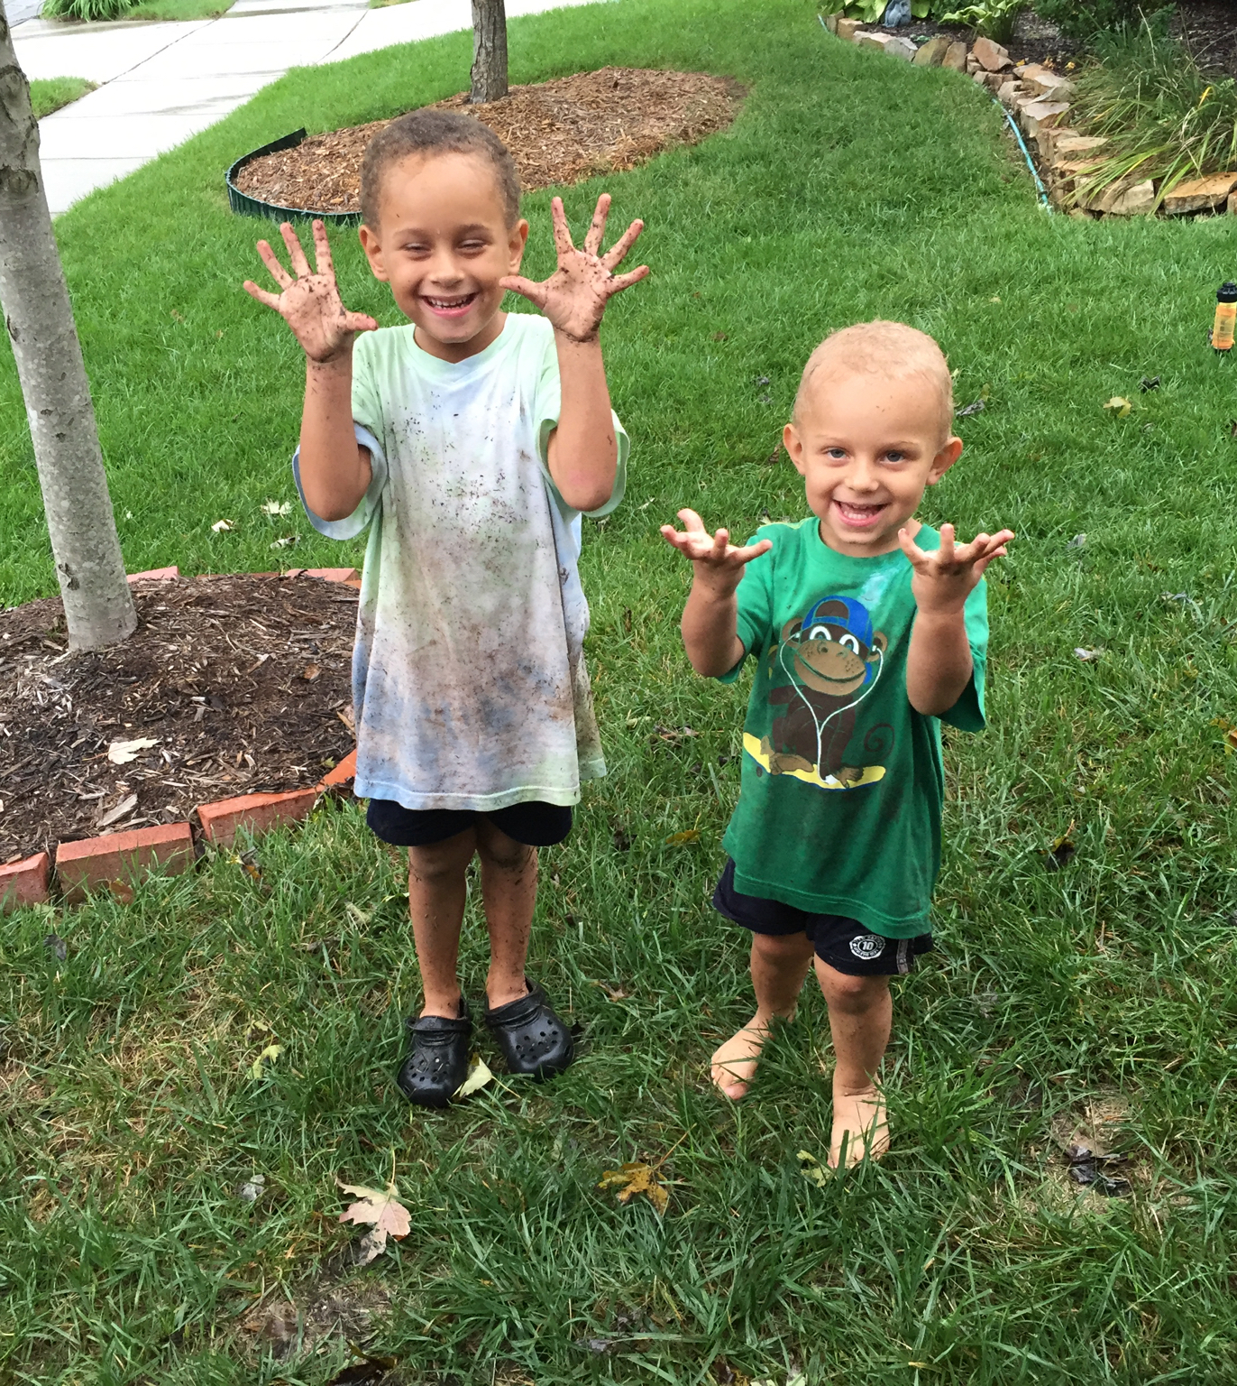
Questions
BreastfeedDurham.org
BreastfeedingCommunities.org
919-622-8787
durham@breastfeedingcommunities.org

Slide 45
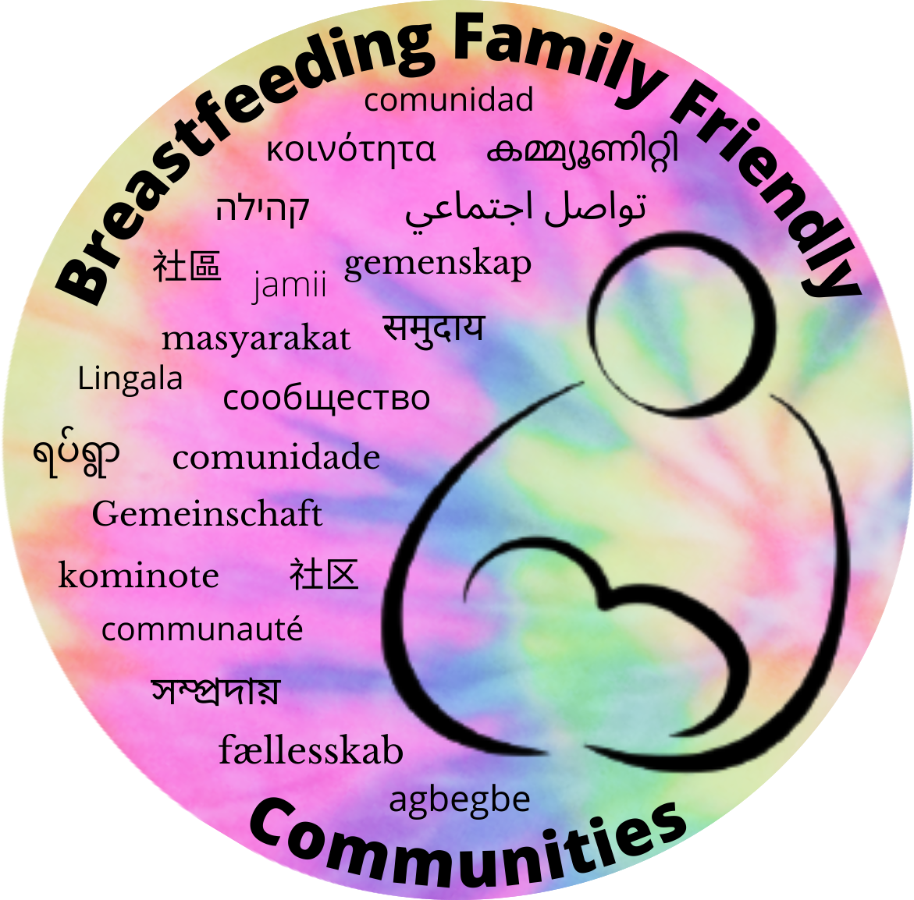
Questions?
In time, every family that wants to chest/breastfeed will receive education and support that enables the family to continue for as long as that family chooses.
durham@breastfeedingcommunities.org
andrea.dotson@duke.edu
https://breastfeeddurham.org
This presentation was made possible in part by Breastfeeding Family Friendly Communities, the Durham County Department of Public Health, and the generosity of the Durham, NC community.
BreastfeedingDurham.org

